Slide 1
Verilog HDL
Basic Gates

Slide 2
INTRODUCTION TO HDL
It is textual description of a digital circuit.
Currently, there are two widely used HDLs – Verilog and VHDL (Very high speed integrated circuit Hardware Description Language).
Advantages
describe a large complex design requiring hundreds of logic gates in a convenient manner, in a smaller space.
use software test-bench to detect functional error, if any and correct it (called simulation).
get hardware implementation details (called synthesis). Hardware Description Language, more popular with its acronym HDL is an answer for that.

Slide 3
History
Introduced in 1980, primarily as a simulation and verification tool by Gateway Design Automation, it was later acquired by Cadence Data Systems.
public domain in 1990, it gained popularity and is now controlled by a group of companies and universities, called Open Verilog International.
The reader with an exposure to any programming language like C will find it relatively easier to learn Verilog or any HDL.

Slide 4
Verilog HDL
Describing Input Output
In any digital circuit, we find there are a set of inputs and a set of outputs, often termed as ports.
Note that, all keywords are written in bold.
Notes:
Module name can be (a-z, 0-9, or -), but caannot to start with 0-9 or -

Slide 5
Verilog HDL
Writing Module Body
There are three different models of writing module body in Verilog HDL.
We start with structural model by example of two-input OR gate
data flow model and behavioral model are the other two models

Slide 6
Rules
Verilog supports predefined gate level primitives such as and, or, not, nand, nor, xor, xnor etc.
The syntax followed above can be extended to other gates and for 4 input OR gate it is as given next,
or (output, input 1, input 2, input 3, input 4)
For NOT gate, not (output, input)
Note that, Verilog can take up to 12 inputs for logic gates.
Comments when extends to next line is written within /* ..... */.
Identifiers in Verilog are case sensitive, begin with a letter or underscore and can be of any length.

Slide 7
Main Module
module or_gate(A,B,Y);
input A,B; // defines two input port
output Y; // defines one output port
or g1(Y,A,B); /*Gate declaration with predefined keyword or representing logic OR, g1 is optional user defined gate identifier */
endmodule

Slide 8
Test Bench Module
module testor;
reg A,B;
wire x;
or_gate org(A,B,x);
initial
begin
A= 1’b0; B=1’b0;
#20
A= 1’b0; B=1’b1;
#20
A= 1’b1; B=1’b0;
#20
A= 1’b1; B=1’b1;
#20 finish;
end
endmodule

Slide 9
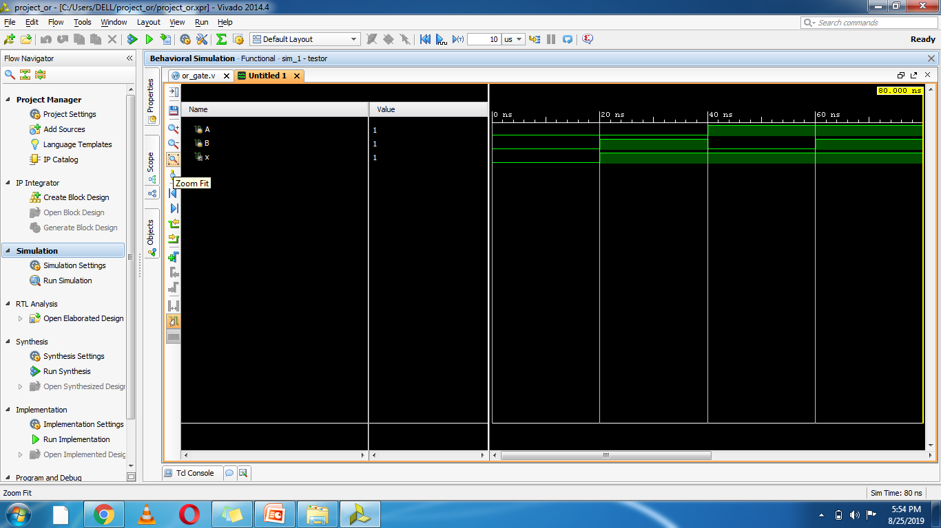
Output

Slide 10
End of class

